Slide 1
Optimization with Metaheuristics Nature’s Calculator
Mitchell Schepps¹, Weng Kee Wong¹
¹UCLA Department of Biostatistics, Los Angeles, CA

Slide 2

Areas of focus for this talk
Optimization definitions
Metaheuristics – deep dive
Solve and code in R
Software packages

Slide 3
Areas of focus for this talk
Optimization definitions
Metaheuristics – deep dive
Solve and code in R
Software packages

Slide 4
Optimization - Definitions
Optimization - Maximizing or minimizing a real function
Combinatorial Optimization – Finding an optimal object from a finite set of objects
Function to be maximized/minimized = cost function
For instance, minimize f(x)

Slide 5
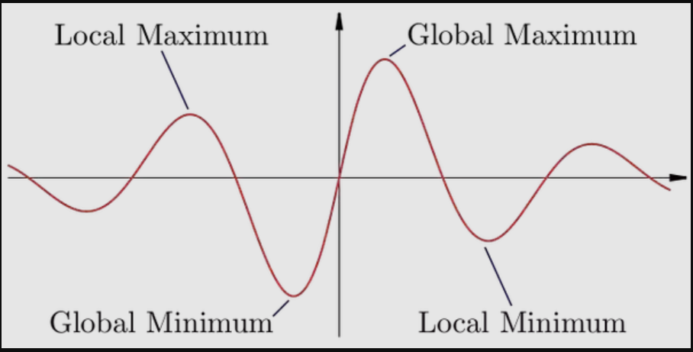
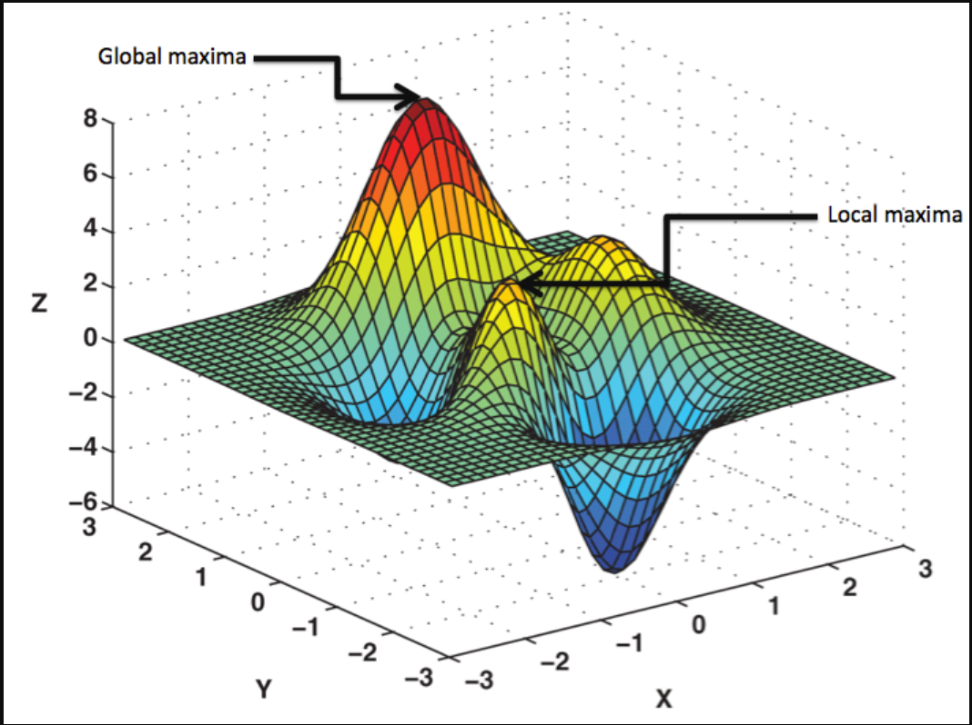
Optimization – Minimums and Maximums
2-D Optimization Problem
3-D Optimization Problem

Slide 6
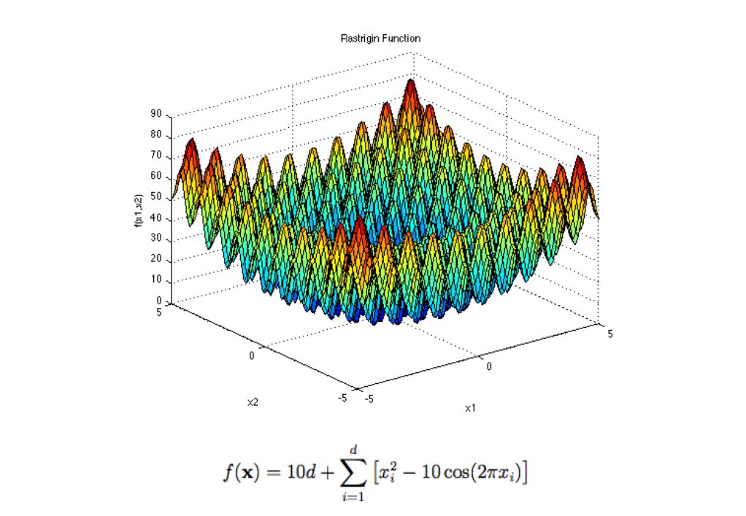
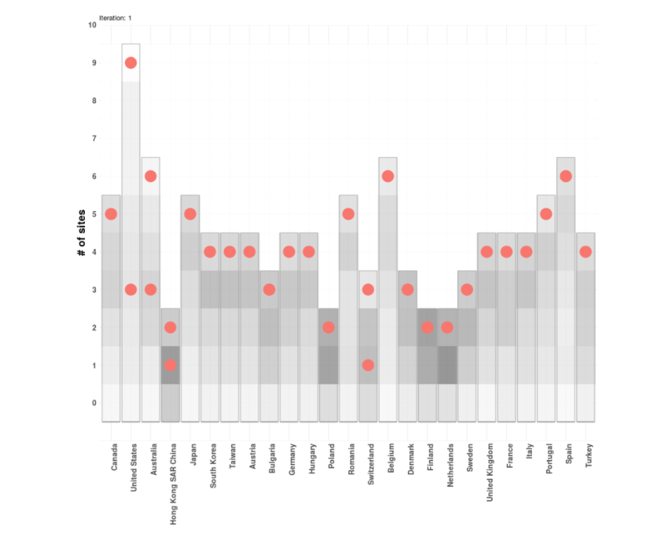
Optimization – Minimums and Maximums
3-D Optimization Function
Combinatorial Optimization Problem

Slide 7
Areas of focus for this talk
Optimization definitions
Metaheuristics – deep dive
Solve and code in R
Software packages

Slide 8
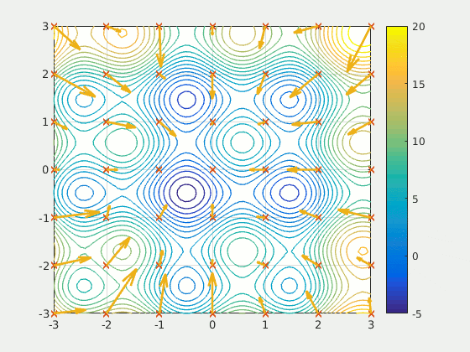
Metaheuristics
Natural behaviors lead the “guided search”.
Exploration – Search the space for a good solution
Communication – Transfer information between other members of the search
Exploitation – Intensely search a good area
This Photo by Unknown Author is licensed under CC BY-SA

Slide 9

Metaheuristics
Three Different Classes
Evolution Based
Swarm Based
Physics Based
Follow Darwinian principles
Genetic Algorithms
Differential Evolution
Populations move in conjunction with each other
Particle Swarm Optimization (PSO)
Ant Colony Optimization
Artificial Bee Colony Optimization
Based on principles found in the real world
Black Hole Optimization
Gravitational Search Algorithm
Sine-Cosine Algorithm
Evolutionary Based

Slide 10
Particle Swarm Optimization (PSO)
Metaheuristic inspired by flocks of birds and schools of fish (Kennedy and Eberhart, 1995)
Initiate particles at random points
Particles’ velocity is updated based on personal best position and global best position
X(t) = current position of particle at iteration t
V = velocity, t = current iteration, t+1 = future iteration
Pbest = personal particle best, Gbest = global particle best
3. Evaluate cost at each iteration
4. Repeat steps 2 and 3 until convergence (or max iterations)

Slide 11
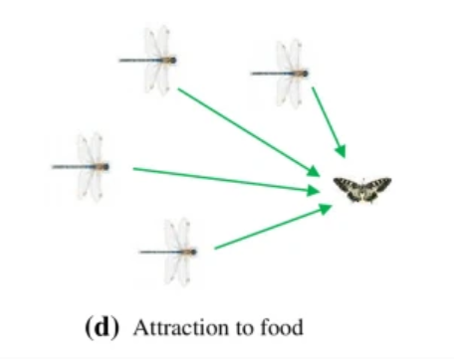
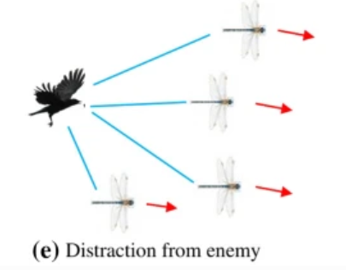
Dragonfly Algorithm
Swarm intelligence
Dragonflies fly in alignment, separation, and cohesion.
Dragonflies hunt food and distract from predators in packs
Tuning parameters include
Number of dragonflies
Separation weight
Alignment weight
Cohesion weight
Food factor
Enemy Factor
Inertia weight

Slide 12
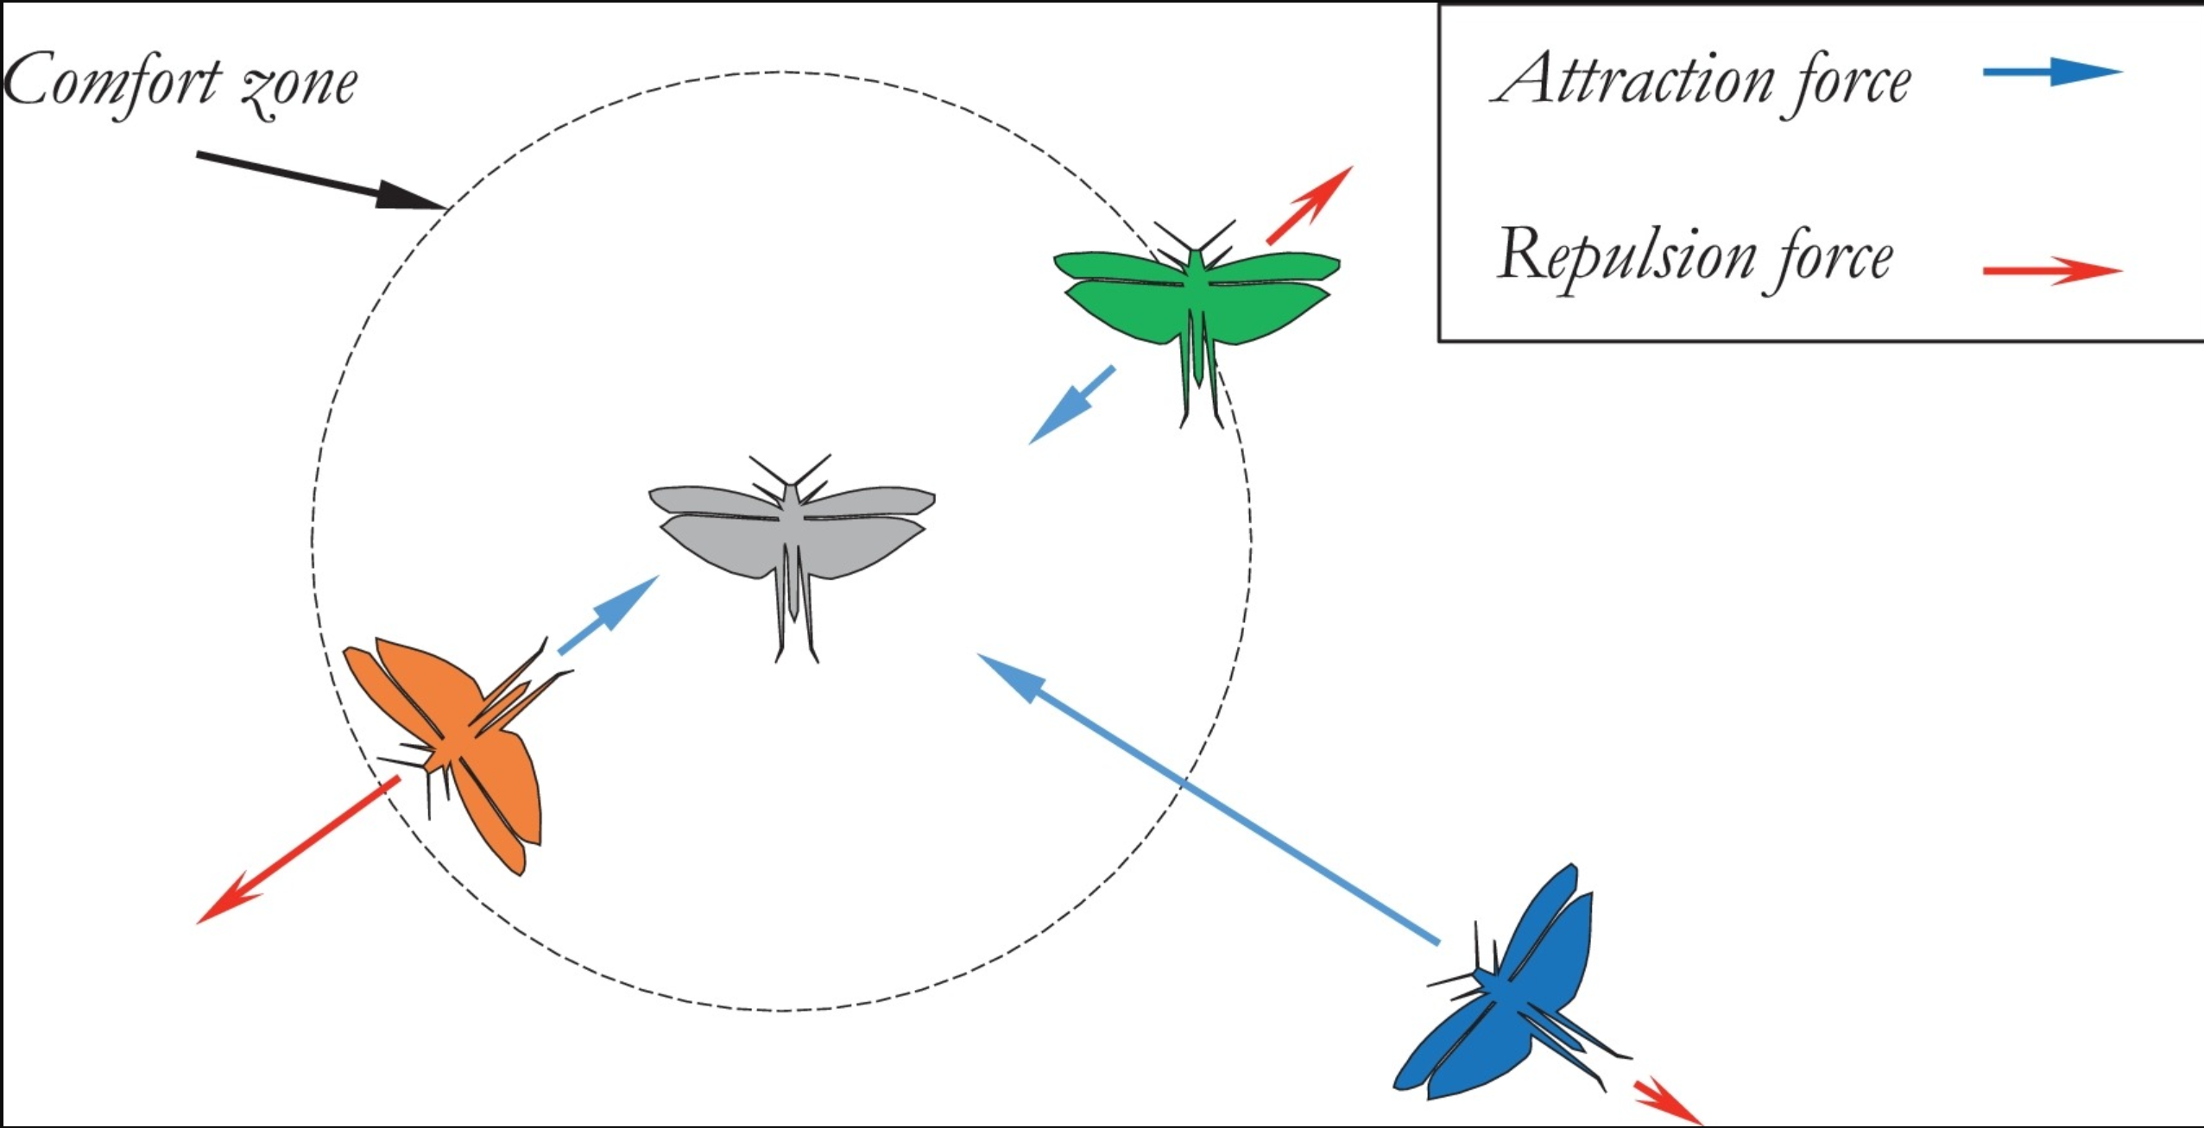
Grasshopper Optimization Algorithm
Swarm intelligence
Each grasshopper has a boundary and comfort zone.
Adult grasshoppers leap great distances and explore.
Baby grasshoppers roll around and exploit.
Tuning parameters include
Number of grasshopper
Attraction intensity
Attraction longitudinal scale
Comfort Zone minimum
Comfort Zone maximun

Slide 13
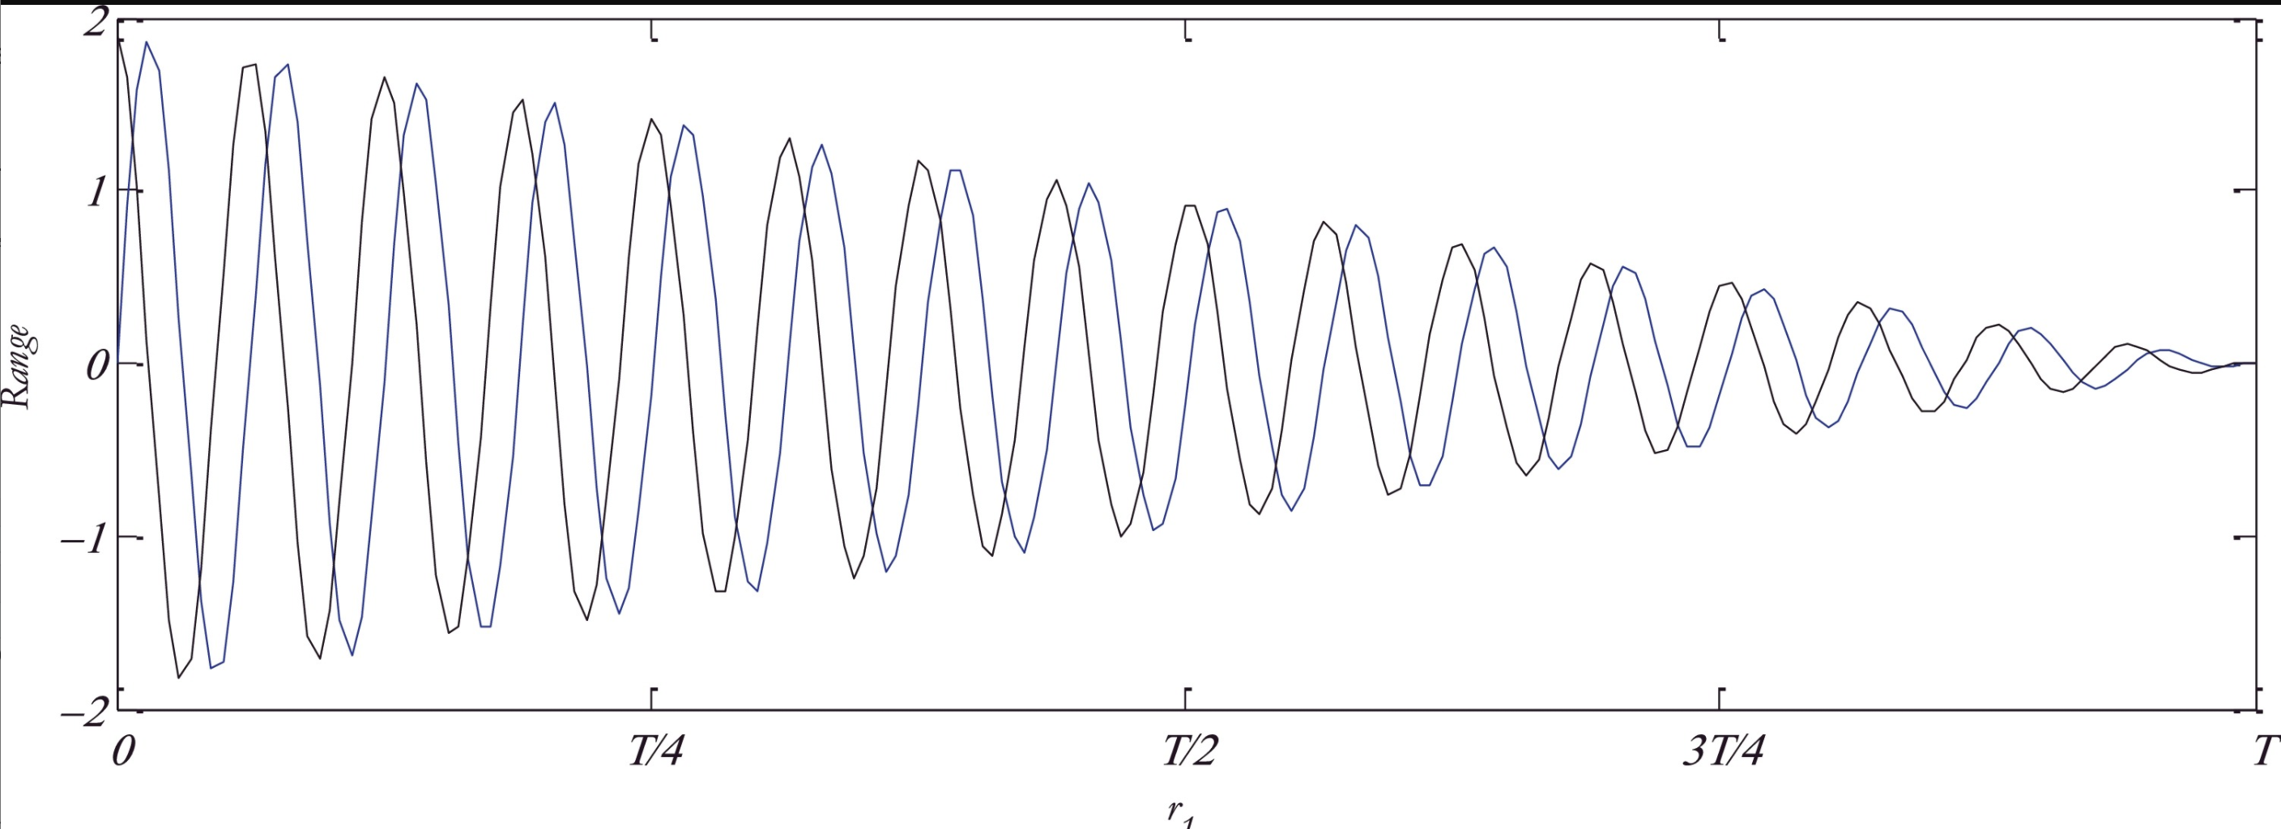
Sine-Cosine Algorithm
Physics based swarm intelligence
Particles are initialized like in PSO
Properties of Sine and Cosine are used to search
Best position is updated each time.
Tuning parameters include
Number of initial particles
Random weights associated with the exploration and exploitation phases

Slide 14
Areas of focus for this talk
Optimization definitions
Metaheuristics – deep dive
Solve and code in R
Software packages

Slide 15
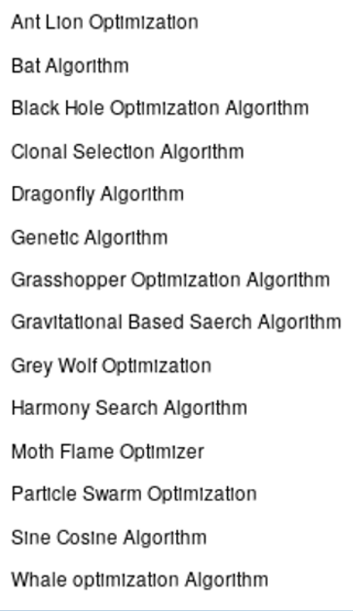
Metaheuristics used in R
R package ‘metaheuristicOpt’ (Lala Septem Riza, 2019)
Rastrigin function
Linear Regression
Logistic regression
Single Layer Neural Network
Hidden Layer Neural Network
Optimal Design

Slide 16
Areas of focus for this talk
Optimization definitions
Metaheuristics – deep dive
Solve and code in R
Software packages

Slide 17


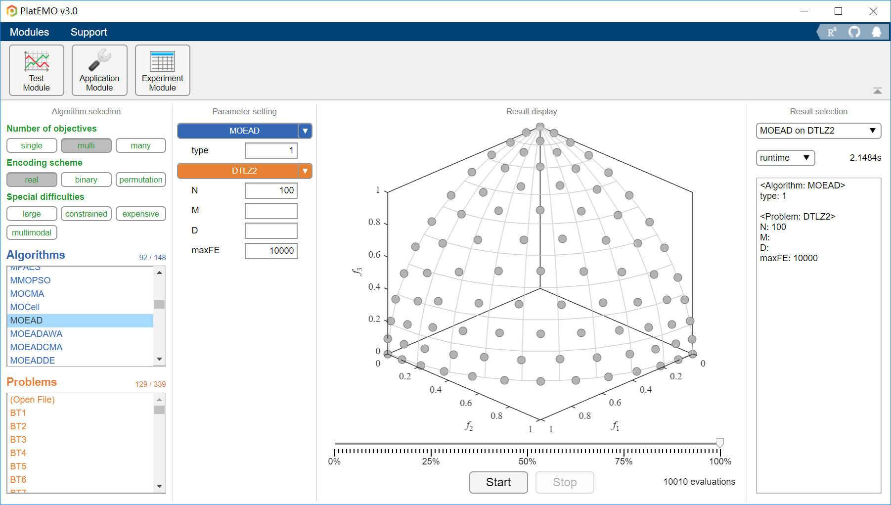
PlatEMO
An evolutionary single- and multi-objective optimization platform based on MATLAB
150+ algorithms and 300+ problems
Powerful GUI
https://github.com/BIMK/PlatEMO

Slide 18
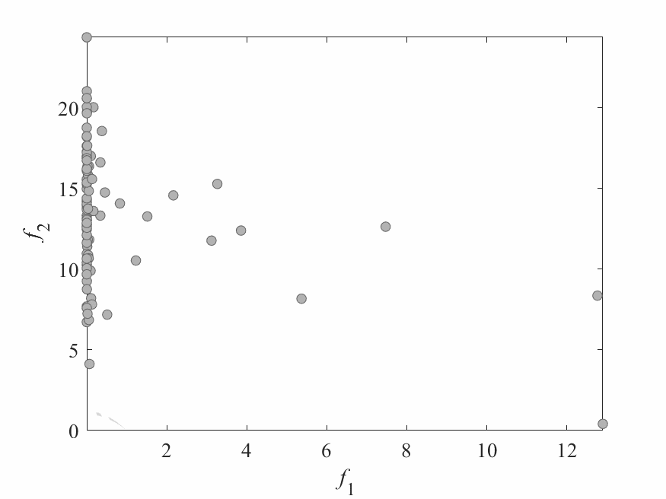
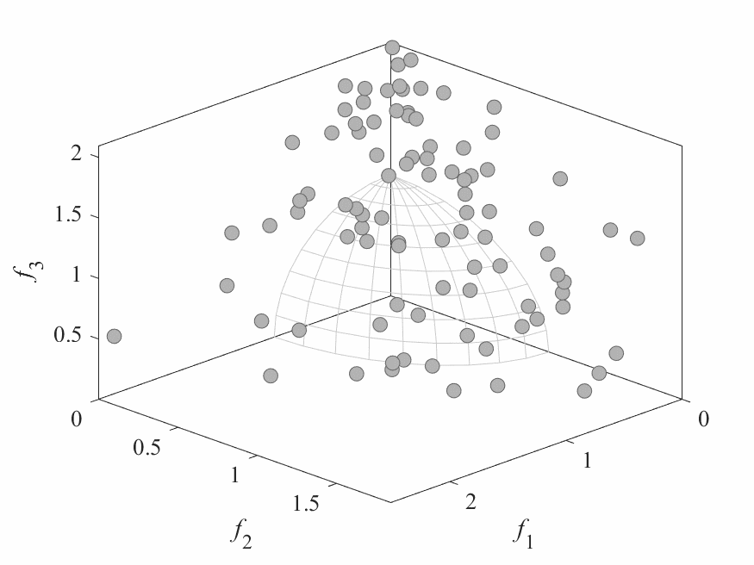
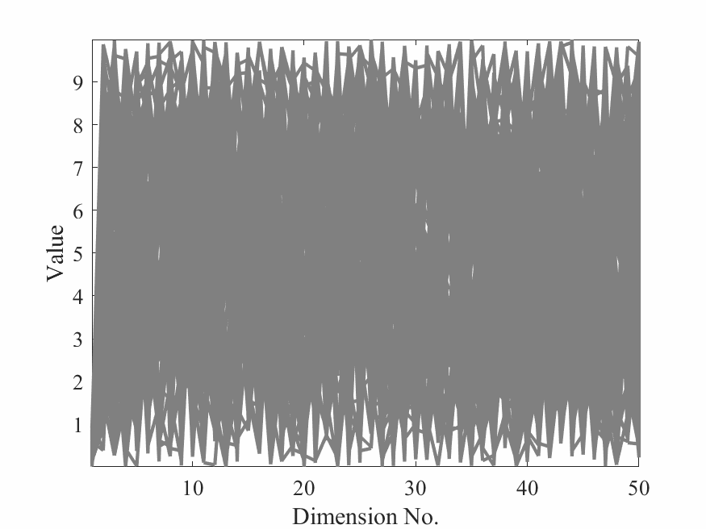
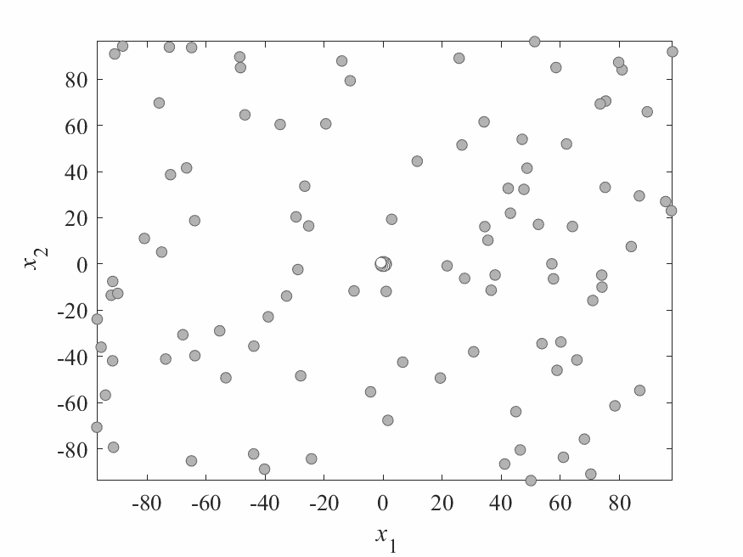
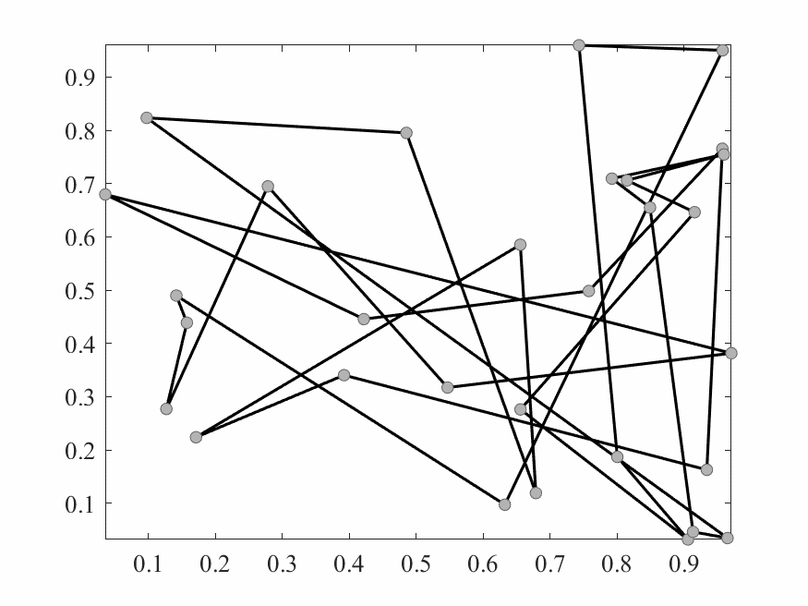
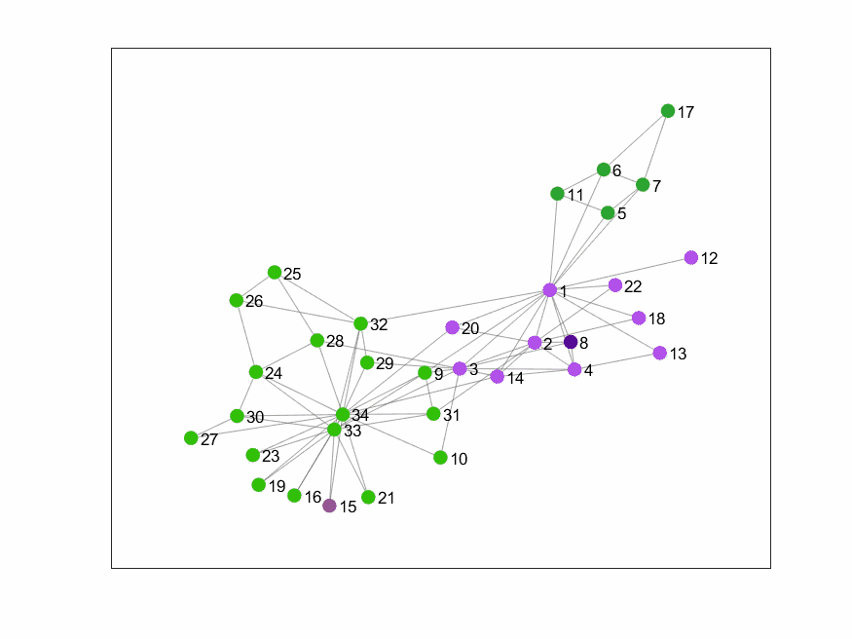
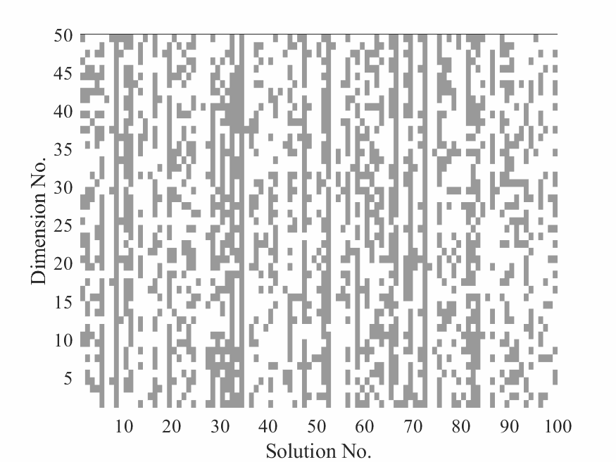
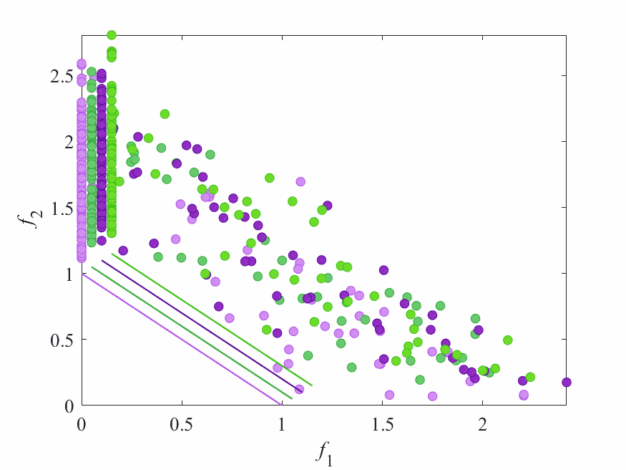
Constrained optimization
Multi-objective optimization
Large-scale optimization
Many-objective optimization
Vehicle routing
Community detection
Binary optimization
Multimodal optimization

Slide 19

5. Tuning Metaheuristics
Metaheuristic algorithms give us varying answers.
Tuning parameters may navigate us towards better optima by varying the exploration and exploitation variables.
The racing algorithm provides a procedure to a quick, good solution (Birattari, 2009)
irace package (v3.4.1; López-Ibáñez et al., 2016).

Slide 20
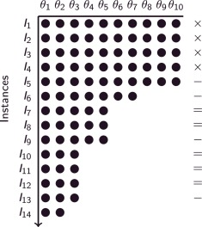
Racing Algorithm
Grid search tests exhaustively all of the combinations.
Iterated racing procedure
Step 1: Sample parameter configurations Θ
Step 2: Evaluate
Step 3: After 5 iterations, run a pairwise difference test.
Step 4: Eliminate those configurations significantly different than the best values configuration.
Step 5: Stop at 14 iterations
Θ: tuning parameter configuration
x: no statistical test is performed
-: the test discarded at least one Θ
=: the test did not discard any Θ

Slide 21
Racing Algorithm
Grid search tests exhaustively all of the combinations.
Iterated racing procedure
Step 1: Sample parameter configurations Θ
Step 2: Evaluate
Step 3: After 5 iterations, run a pairwise difference test.
Step 4: Eliminate those configurations significantly different than the best values configuration.
Step 5: Stop at 14 iterations
Θ: tuning parameter configuration
x: no statistical test is performed
-: the test discarded at least one Θ
=: the test did not discard any Θ

Slide 22
Racing Algorithm
Grid search tests exhaustively all of the combinations.
Iterated racing procedure
Step 1: Sample parameter configurations Θ
Step 2: Evaluate
Step 3: After 5 iterations, run a pairwise difference test.
Step 4: Eliminate those configurations significantly different than the best values configuration.
Step 5: Stop at 14 iterations
Θ: tuning parameter configuration
x: no statistical test is performed
-: the test discarded at least one Θ
=: the test did not discard any Θ

Slide 23
5. Tuning Setup
Algorithm | Tuning Parameter | Nickname | Default | Range
PSO | Personal Best | PSO.PBest | 1.465 | 0 – 60
PSO | Global Best | PSO.GBest | 1.012 | 0 – 60
PSO | Velocity Max | PSO.Vmax | 2 | 0 – 100
GA | Prob Mutation | GA.M | 0.1 | 0 – 1
GA | Prob Crossover | GA.C | 0.8 | 0 - 1
Tuning PSO and Genetic Algorithm (GA)
Personal Best
Global Best
Velocity Max
Prob of Mutation
Prob of Crossover
3 comparisons at 50 simulations
Default parameters
Randomly selected parameters
Tuned parameters

Slide 24
5. Tuning Setup
Algorithm | Tuning Parameter | Nickname | Default | Range
PSO | Personal Best | PSO.PBest | 1.465 | 0 – 60
PSO | Global Best | PSO.GBest | 1.012 | 0 – 60
PSO | Velocity Max | PSO.Vmax | 2 | 0 – 100
GA | Prob Mutation | GA.M | 0.1 | 0 – 1
GA | Prob Crossover | GA.C | 0.8 | 0 - 1
Tuning PSO and Genetic Algorithm (GA)
Personal Best
Global Best
Velocity Max
Prob of Mutation
Prob of Crossover
3 comparisons at 50 simulations
Default parameters
Randomly selected parameters
Tuned parameters

Slide 25
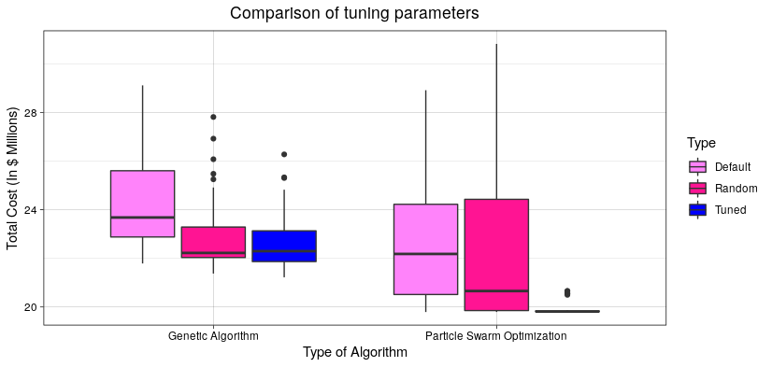
5. Racing Algorithm Results
Tuning result after 50 simulations
Tuning Parameter | Range | Default | Tuned
PSO.PBest | 0 – 60 | 1.465 | 26
PSO.GBest | 0 – 60 | 1.012 | 1
PSO.Vmax | 0 – 100 | 2 | 86
GA.M | 0 – 1 | 0.1 | 0.4
GA.C | 0 - 1 | 0.8 | 0.9

Slide 26
Future Directions
Determine what is the best answer.
Determine convergence criterion for different algorithms
Test Tuning Parameters
Kubernetes/Parallelization

Slide 27
Results
Scenario 1: Phase IIB Trial for UC – 240 Patients, 49 countries, 18 months to completion.
Which algorithm gives us the best design?
Enrollment Modeling Summary Statistics
 | Simplex | Dragonfly | Grasshopper | Sine-Cosine
Cost | $3,054,541 | $3,545,823 | $3,091,256 | $2,983,349
Probability | 70% | 71.3% | 71.0% | 69.6
Number of Centers | 103 | 114 | 105 | 96
Number of Countries | 15 | 36 | 26 | 8

Slide 28
Results
Scenario 2: Phase III Trial – 180 Patients, 16 countries, 24 months to completion.
Which algorithm gives the best distribution of sites given number of countries, probability of success, and cost are equal?
Number of Sites Per Country
 | Simplex | Dragonfly | Grasshopper | Sine-Cosine
Country 1 | 0 | 0 | 2 | 0
Country 2 | 0 | 2 | 0 | 5
Country 3 | 5 | 5 | 2 | 4
Country 4 | 6 | 2 | 3 | 1
Country 5 | 7 | 1 | 0 | 5
,,, | … | … | … | …
Country 16 | 7 | 6 | 7 | 2

Slide 29
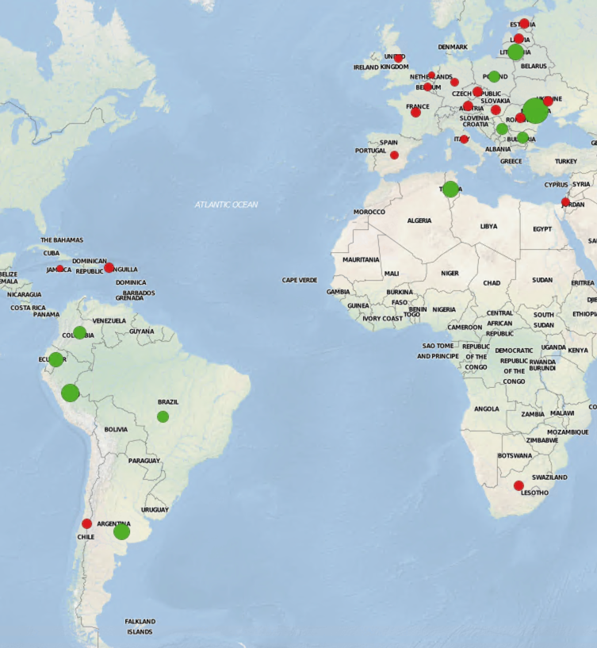
What countries should be selected for trial? How many sites should be in each country?
Need reasonably high confidence of meeting enrollment target time (e.g. 12 months)
Desire lower cost alternatives given we can achieve the target timeline with reasonable confidence

